Slide 1
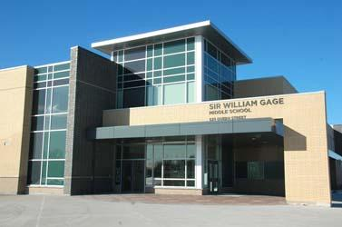
Welcome to Curriculum Night
September 30, 2014

Slide 2
Sixth Grade at a Glance
2014-2015
6CG Ms. Gardener – Rm. 202
6CB Ms. Bess – Rm. 203
6ED Ms. Dyck – Rm. 204
6DZ Ms. Zimmerman – Rm. 205
6CR Ms. Roman – Rm. 206
6DR Ms. Ratwatte – Rm. 207
6KM Mr. Kyle – Rm. 208
6DS Ms. Sharma – Rm. 209
6JE Ms. Eubanks – Rm. 210
6YA Ms. Aroso– Rm. 212
ISSP Teacher- Ms. Zinn/ Ms. Young
Phys. Ed - Ms. Held/Mr. Kim
Visual Arts -Ms. Bailey
Music - Ms. Kim/Ms.Palmeri/Mr. Lee

Slide 3
Curriculum Points –Term 1
An Exciting Year Awaits!
OUR BIG IDEA:
‘Identity- What does it mean to be Canadian?’
Language:
  The Daily Five
Mathematics:
  Math-based IBL – School-wide Mathematics focus
  Mathletics!
Science
  Electricity, Space
Social Studies
  Culture and Canadian Heritage/Identity

Slide 4
Welcome to Grade 6
  The Daily 5 is more than a curriculum framework – it is a structure that will help students develop the daily habits of reading, writing and working with peers that will lead to a lifetime of independent literacy.
  The Daily 5 is a series of literacy tasks which students complete daily while the teacher meets with small groups or confers with individuals.

Slide 5

Welcome to Grade 6
One of the first parts of Daily 5 is introducing the three ways to read a book. They are:
Read the Pictures
Read the Words
Retell the Story

Slide 6
Why Daily 5?
The goal of the Daily 5 is to have students gain control over what they read and write and the order in which they do the Daily 5.

Slide 7
MATH TALK:
Whole Group Lesson Daily
Guided Math
Problem Solving
Math Centers Daily
  -Grab and Go!
  -Independent Work
-Small Group Instruction

Slide 8
More on MATH
Skills will be taught using:
Manipulatives
Examplars
Games
Technology
Mathletics

Slide 9
MATH TALK:
Mathletics:
What is Mathletics?
Mathletics is a web-based learning
program that integrates home and
school learning via the internet.

Slide 10
Prodigy:
This is a self-paced Math game that allows teachers to view reports on what students are learning in a play based platform. Each students is given their own password to access the their account.

Slide 11
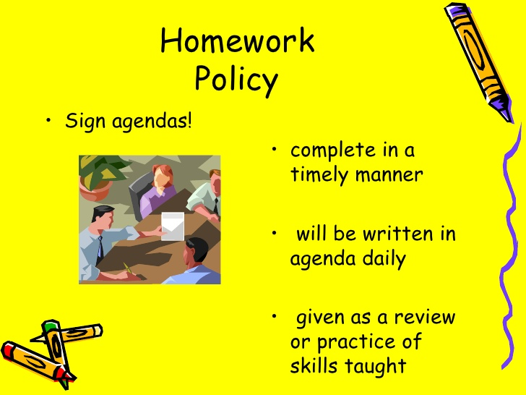

Slide 12

Homework Policy
Mathletics
Math Prodigy
Reading:
- 20 Minutes or more

Slide 13
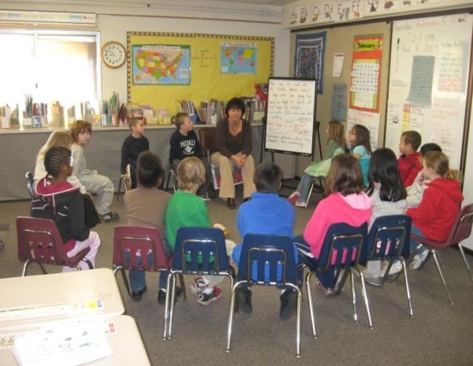
Restorative Circles
THE CIRCLE IS:
A WAY OF TALKING TOGETHER IN WHICH ALL OF US...
• are respected and treated equally
• have the opportunity to speak without interruption
• tell our own stories
• speak and listen in a deeper, more heartfelt way

Slide 14
Restorative Circles
VALUES UNDERLYING CIRCLES:
•mutual concern & respect
•shared responsibility
•consensual decision-making
•personal accountability
•appreciation of differences
•equal opportunity

Slide 15
Restorative Circles
CIRCLES CAN BE USED TO:
achieve greater mutual understanding
develop a spirit of cooperation and collaborative skills
make decisions together, building consensus
develop agreements that bring resolution and closure
work through differences and difficult issues
repair, heal, and build relationships and a sense of community

Slide 16
The CHAMPs Acronym
C-- Conversation
H-- Help
A-- Activity
M-- Movement
P-- Participation

Slide 17
The CHAMPs Acronym
A Proactive and Positive Approach to Classroom Management!
Champs behavior is a very important part of our Gage Community.
This is a model for what we expect our students to look and sound like at school during our day.
Each letter stands for something that will help your child understand how to be a CHAMP.
C-- Conversation Can students talk to each other during this activity?
H-- Help How do the students get teacher’s attention and questions answered?
A-- Activity What is the task and the objective?
M-- Movement Can students move about during this activity?
P-- Participation What does the work behavior look and sound like?

Slide 18
What’s changed?
Effective Sept. 2013:
Social Studies Curriculum has changed

Slide 19


Music
J. Kim, G. Lee and A. Palmeri
Room # 108 & #109
“Working together as a team, in a supportive community environment, to develop musical skill and creativity.”
Musicianship
Performance Skills
Developing Creativity
Understanding Culture
Community
Working together
Supportive environment
Building positive personal identity

Slide 20

Ms. Bailey and
The Art Zone!
I teach your child(ren) Visual Arts (all grades)
Please feel free to reach me by telephone
(905-456-3394) ext. 220/221 or by writing a note in your child’s age agenda.
The Art Zone Website will be up and running soon.

Slide 21
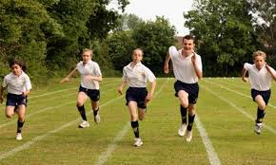
Physical Education
H. Kim & A. Held
The knowledge and skills acquired in the physical education program is designed to develop the comprehension and commitment needed to lead healthy, active lives
This includes:
Participating regularly and safely in physical activity and learning how to develop and improve their own personal fitness
Developing competence needed to participate in a wide range of physical activities
Understanding the factors that contribute to
healthy development and a sense of
personal responsibility for lifelong health

Slide 22

Visit the Sir William Gage Library for information on upcoming events like the Scholastic Book fair and Community Connections, as well as how to access our website…
with links to many learning resources. PICK UP A BROCHURE!

Slide 23
Oh, The Places You’ll Go!
FIELD TRIPS
City Hall
Lego Land
The Apple Store
Outdoor Education
Stay tuned for more details…
-CHAPERONES ARE NEEDED!!
Please be reminded that a police background check is required for all school volunteers in Ontario. Even if you want to accompany your child on a field trip, you need this background.

Slide 24
How to Help your Child?
Discuss each learning skill with them.
Talk about which skills they effectively demonstrate now, celebrate this with them.
Choose a skill area to work towards, set a goal and make a plan together on how your child can improve.
Share the goal with your child’s teacher.
When your child makes progress, celebrate that success with them and then set a new goal!

Slide 25
How will your child show their learning?
Assessment for learning – Teachers will find out where students’ knowledge starts so they can go from there
Example: Having a class discussion about how the human body works before beginning the unit to find out what students already know

Slide 26
How will your child show their learning?
Assessment as learning - students use teacher feedback and self assessment to determine next steps to improve their learning
Example: Student writes a story and receive descriptive feedback from teacher. Student then uses that feedback to re-write and improve their story
There is less emphasis on marks/percentages, and more of a focus on personalized comments to improve student work.

Slide 27
How will your child show their learning?
Assessment of learning - information gathered to communicate student’s achievement to parents, other teachers, students
Example: Quizzes, tests, assignments, projects, blogging

Slide 28
Big Ideas at a Glance
Language Arts: Helping students to become better critical readers, writers, listeners, and viewers.
Math: Developing students’ problem solving skills.
Science: Understanding science and technology and the implications on society and the environment.
Social Studies: Examining Canada’s past, present and relationship to the world.
Arts: Using the creative process in all aspects of the arts.

Slide 29
How can you help?
Check your child’s agenda nightly
Set up a homework routine at home
Talk to your kids about what they are doing at school
Review class notes daily
Help your child organize their materials (ex. binders)
Read with and to your children often using all different types of texts (ex. books, newspapers, magazines, etc.) Any kind of reading counts
Review basic math facts (ex. multiplication tables)

Slide 30
Thank you for coming!
Let’s have a great year!

